Slide 1

Intro to NServiceBus
2 – Getting and Installing

Slide 2

Where to get NServiceBus
http://particular.net/NServiceBus
https://github.com/Particular/NServiceBus

Slide 3
Licensing
Various models
No limitations on 4.5 and up (honor system)

Slide 4
Installation
.EXE will be a good tool the first time as a system needs:
NServiceBus binaries
Management Service
MSMQ
DTC
Performance Counters
RavenDB is no longer auto installed, but is still the default persistency model
NServiceBus does not work with Raven 3.0
Must use 2.5.2908 or higher, but < 3.0
http://ravendb.net/downloads/builds

Slide 5
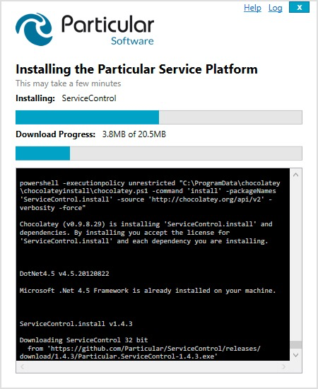
Installing NServiceBus

Slide 6
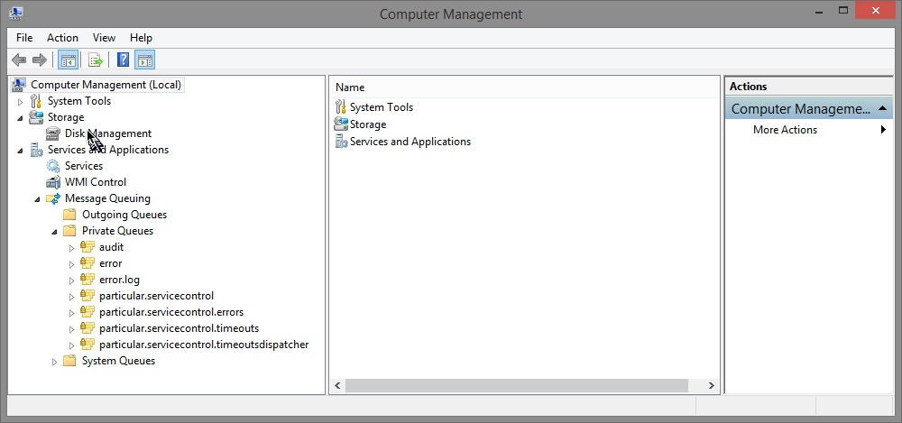
Make sure MSMQ is installed

Slide 7
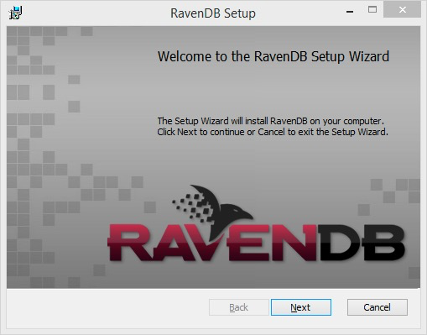
And Install RavenDB
Must use 2.5.2908 or higher, but < 3.0
http://ravendb.net/downloads/builds

Slide 8
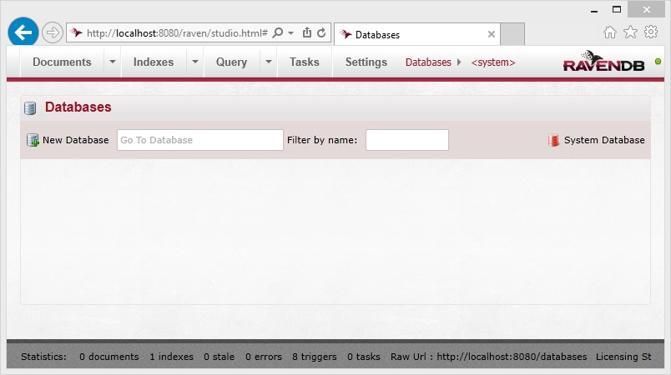
Runs default on localhost:8080

Slide 9
Summary
Covered where to get NServiceBus
And steps through the process of install

